Slide 1
Movable Bridges Automation Feasibility Study
Alameda County Public Works Agency Mandatory Pre-Submittal Conference
May 17, 2022

Slide 2
Agenda for Today
Introductions
General discussion about project, RFQ/P, and procurement process
Review of Important Dates/Deadlines
Review of Project Scope
Review of SLEB requirements
Q and A

Slide 3
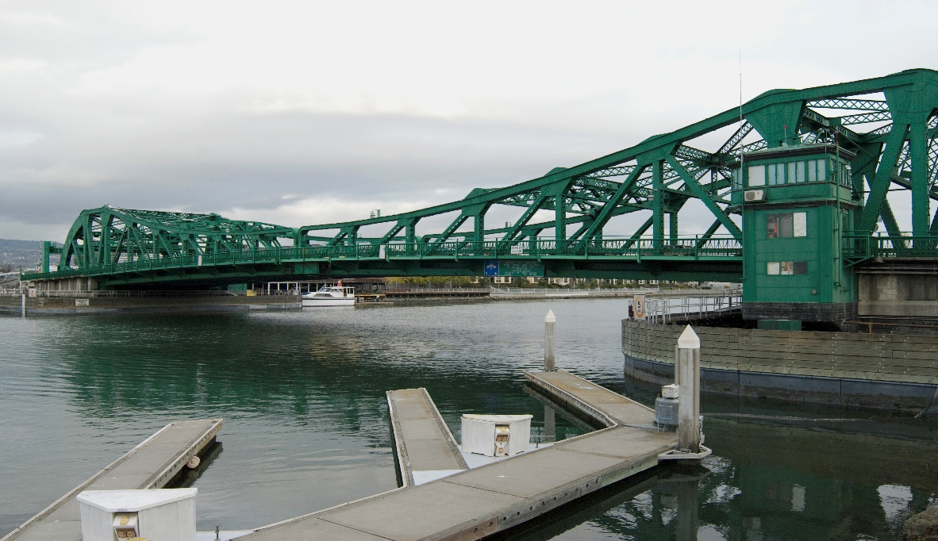
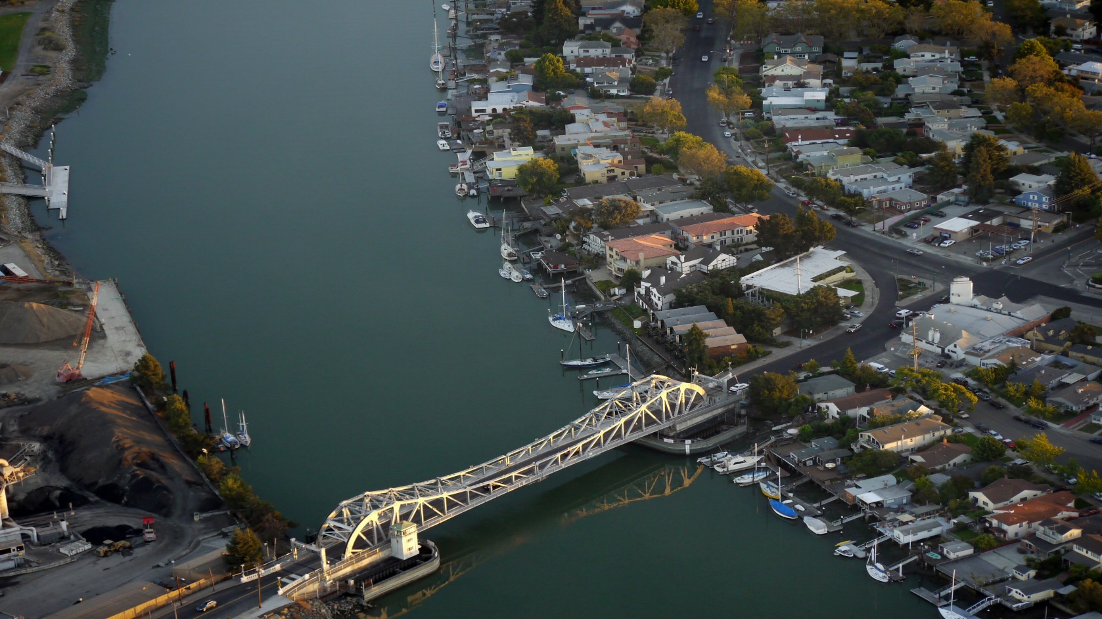
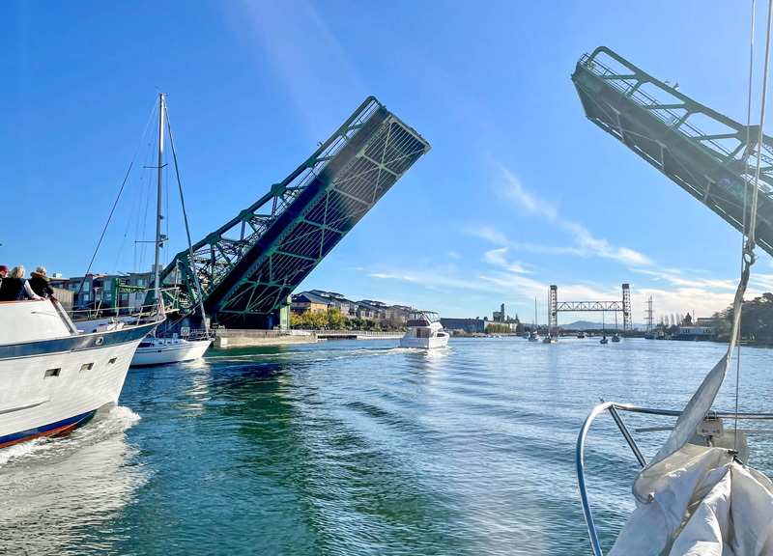
Introductions

Slide 4
Two-Phase Procurement Process
Phase 1: Request for Qualifications/Proposals
Shortlist
Phase 2: Interviews
Team Qualifications and Work Plan
Up to five consultants
Oral presentation & Q/A

Slide 5
Important Dates
May 19 at 5:00 pm: Deadline for submitting questions about RFQ/P.
May 23: Addendum Issued
June 2 by 2:00 pm: RFQ/P Responses due
Week of June 13 *: Interview dates (if conducted)
TBD: Contract award

Slide 6
Bridges Subject to the Study
Alameda County Public Works Agency Summary of Bridges
Bridge Name | Bridge Type | Location | Year Completed | Traffic and Openings (2015 data) | Ownership and Maintenance | Notes
Park Street Bridge | Four-lane double- leaf bascule drawbridge | Crosses Oakland-Alameda Estuary Tidal Channel at Park Street between City of Oakland and City of Alameda | 1935 | Average 40,000 vehicle trips per day; 718 openings | Owner: County of Alameda M&O: ACPWA | Bridge underwent a major rehabilitation project in 2000 that replaced most of the major operational components.
Miller- Sweeney Bridge | Four-lane single- leaf bascule bridge | Crosses Oakland-Alameda Estuary Tidal Channel at Fruitvale Avenue between City of Oakland and City of Alameda | 1973 | Average 21,000 vehicle trips per day; 712 openings | Owner: County of Alameda M&O: ACPWA | Post-incident mechanical machinery inspection performed in 2012. Tentatively slated for replacement.
High Street Bridge | Two-lane double- leaf bascule bridge | Crosses Oakland-Alameda Estuary Tidal Channel at Park Street between City of Oakland and City of Alameda | 1939 | Average 28,000 vehicle trips per day; 583 openings | Owner: County of Alameda M&O: ACPWA

Slide 7
Scope of Project
Task 1: Project Management
Task 2: Existing Data Collection and Review
Task 3: Site Visits
Task 4: Recommendations and Final Feasibility Study Report
Optional Task : Conceptual Phasing Plan and Schedule for Recommended Improvements

Slide 8
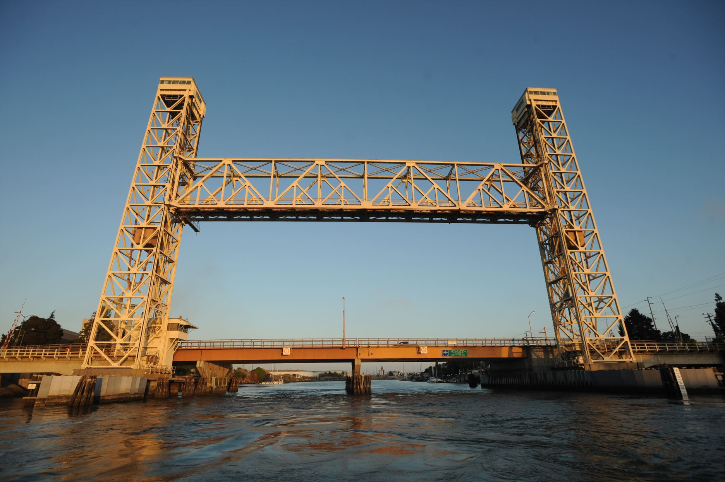
Response Content
Narrative
Understanding of the work to be done
Key Personnel
Relevant Work Experience
Contract Negotiation Authorization
Financial Responsibility
Attachments

Slide 9
SLEB Requirements
20% of work must be performed by SLEBs (Small, Local, Emerging Businesses) as defined by the County
County overview of SLEB program can be found at http://acgov.org/auditor/sleb/overview.htm
Complete Attachment E of the RFQ/P

Slide 10
Official Repository of Information about this Procurement
Alameda County Public Works Agency
https://www.acpwa.org/business/current-opp.page?#profservices.

Slide 11
THANK YOU FOR ATTENDING!
This presentation and the sign-in sheet will be available online.
QUESTIONS?
Patty Aguilera, ACPWA
Alameda County Public Works Agency
951 Turner Court
Hayward, CA 94544
patriciaa@acpwa.org

