Slide 1
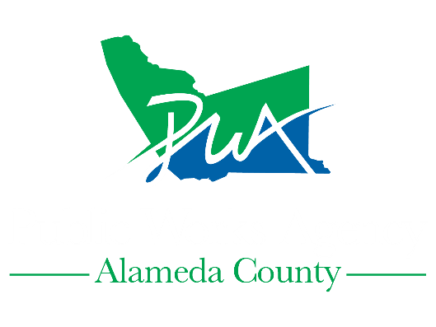
East 14th Corridor Improvement Project
Presentation to Eden Area Business Collective (EABC) at
Small Business Roundtable
October 27, 2020

Slide 2
The Alameda County Public Works Agency started Phase II of the East 14th Corridor Improvement Project in March 2020.
The project is designed to improve safety and access for all users, strengthen community identity and revitalize the corridor.
East 14th Street Corridor Improvement Project

Slide 3
East 14th Street Corridor Improvement Project
Notes:
Bid advertise Fall 2019. Construction start Spring 2020. Contractor Desilva Gates Construction.

Slide 4
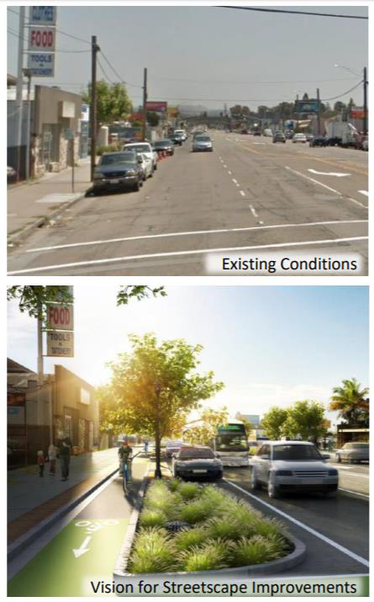

Slide 5
Project Features
New sidewalks
High visibility crosswalks
New bike lanes
Intersection bulb-outs
Raised curb medians
Pavement resurfacing
Pedestrian scale street lights
Street trees
Stormwater treatment system
Utility undergrounding Fiber optic conduit
Bus boarding island Decorative street furnishings
Bike racks
Public art

Slide 6
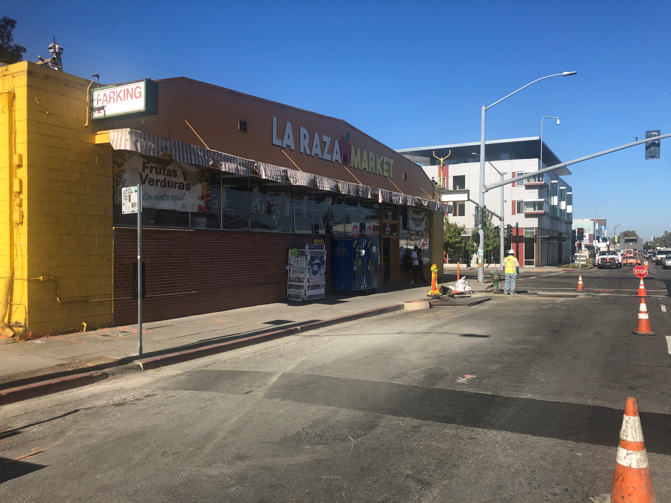
Project Schedule
March 2020 to October 2021
Meetings were held with business and the owners indicated that they were agreeable to our proposal to proceed with construction work during the Thanksgiving Day through January 1st Holiday Season.
We are have began the Stage 2.2/2.1

Slide 7
Construction Hotline: (510) 670-5591
Email: info@acpwa.org
Contact Us

Slide 8
Questions?

